Slide 1

Kevin Boyd & Scott Frazier

Slide 2
Breweries Per State

Slide 3
Missing Values

Slide 4
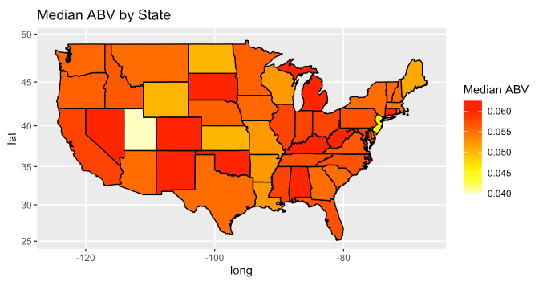
Median ABV by State

Slide 5
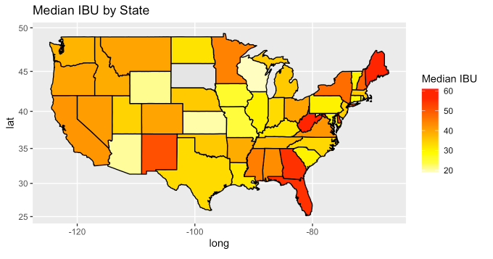
Median IBU by State

Slide 6
Highest ABV and IBU

Slide 7
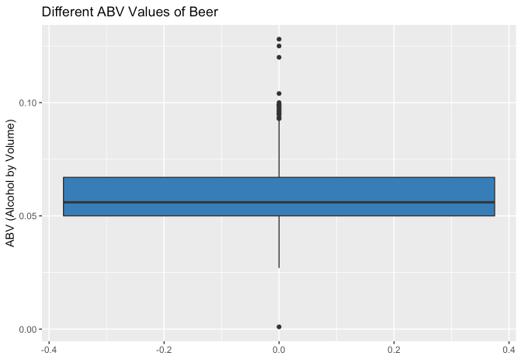
ABV Distribution
Mean: 0.05977
Median: 0.056

Slide 8
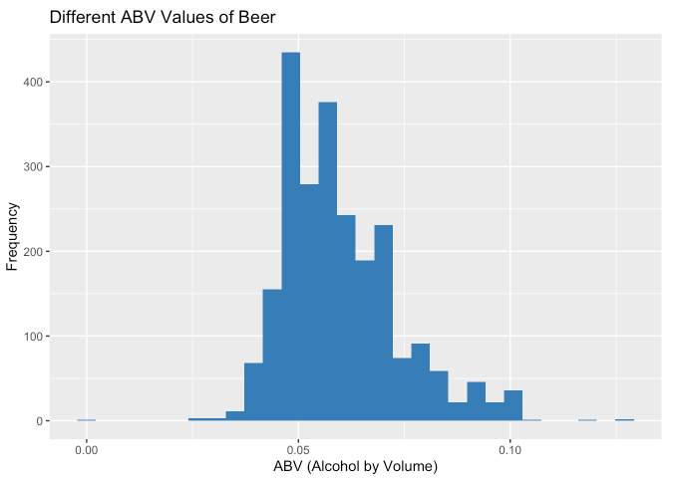
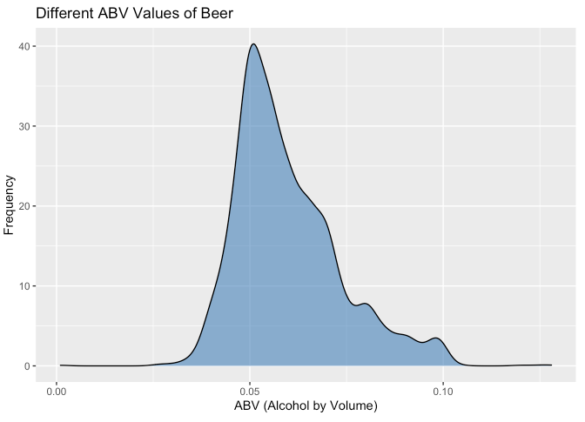
ABV Distribution

Slide 9
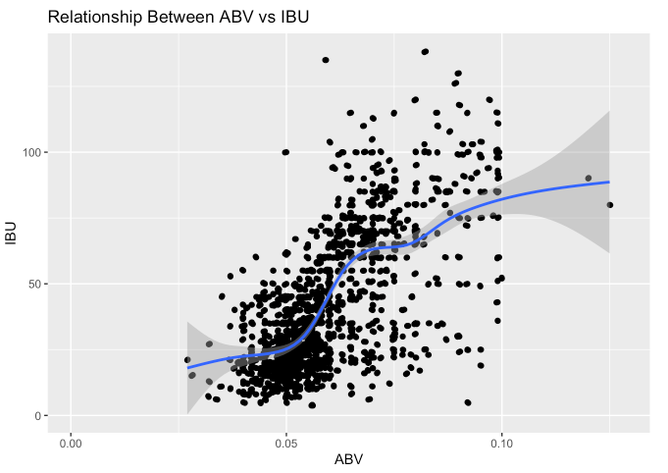
Relationship Between ABV and IBU

Slide 10
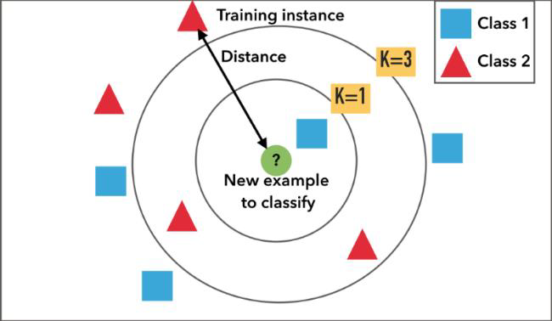
k-NN Model
Kularathne et al., 2020

Slide 11
k-NN Model
Confusion Matrix
k = 10 | ALE | IPA
ALE | 144 | 18
IPA | 20 | 85
Test Metrics
Accuracy | 85.77%
Sensitivity | 87.80%
Specificity | 82.52%
No Information Rate | 61.42%

Slide 12
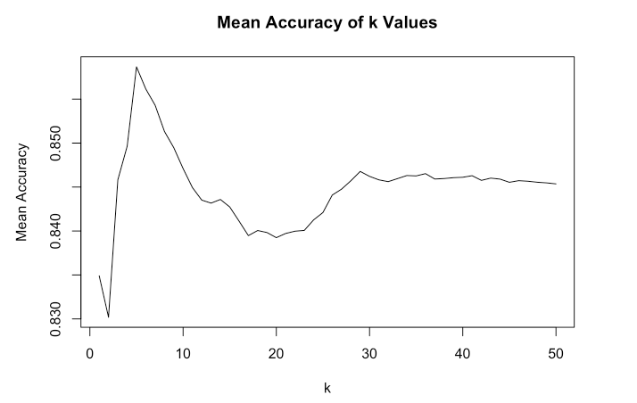
Best Value for K

Slide 13
k-NN Model
Confusion Matrix
k = 10 → 6 | ALE | IPA
ALE | 144 → 145 | 18 → 17
IPA | 20 → 17 | 85 → 88
Test Metrics
Accuracy | 85.77% → 87.27%
Sensitivity | 87.80% → 89.51%
Specificity | 82.52% → 83.81%
No Information Rate | 61.42%

Slide 14
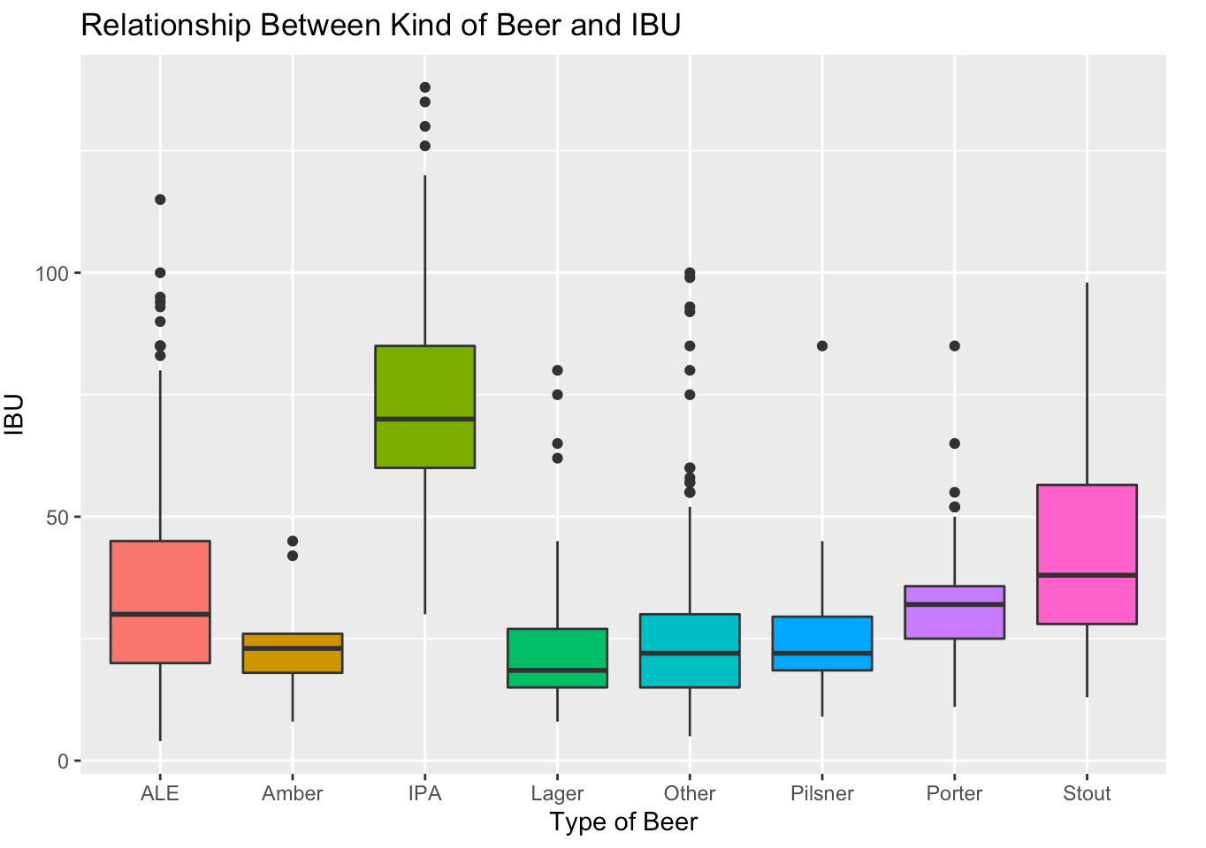
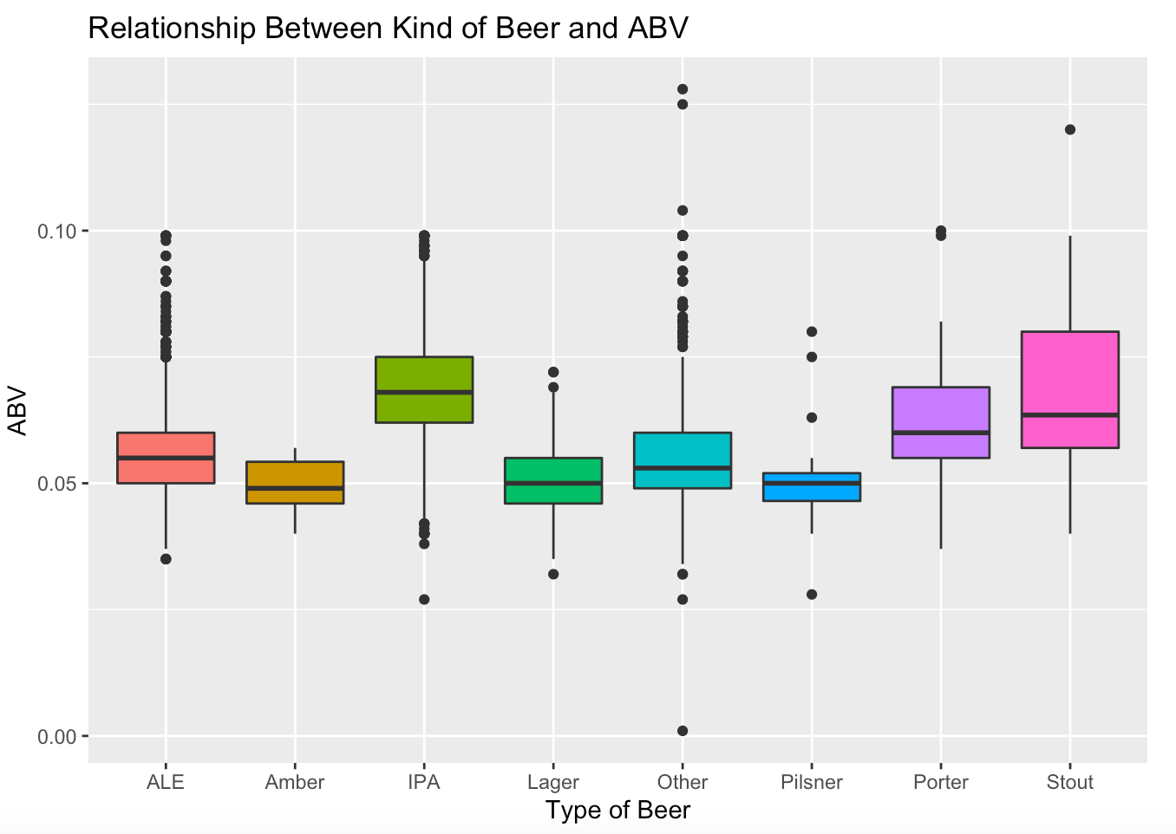
ABV and IBU Distributions

Slide 15
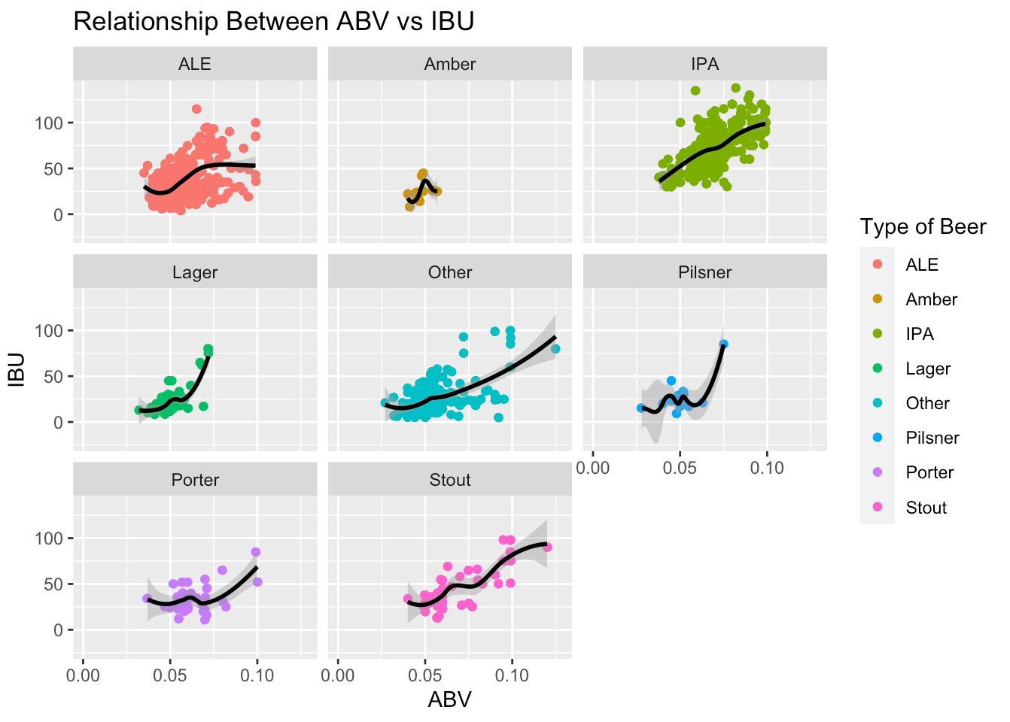
Relationship of ABV and IBU

Slide 16
Conclusion
There appears to be evidence of a positive relationship between ABV and IBU
That relationship also appears to be present when examining specific kinds of beer

Slide 17
Kevin Boyd
Scott Frazier

